Slide 1

SERVLET
DATA BASE CONNECTION

Slide 2
SERVLET
Servlet technology is used to create web application.
Servlet technology is robust and scalable as it uses the java language. Before Servlet, CGI (Common Gateway Interface) scripting language was used as a server-side programming language. But there were many disadvantages of this technology.
Disadvantages of CGI
If number of clients increases, it takes more time for sending response.
For each request, it starts a process and Web server is limited to start processes.
It uses platform dependent language e.g. C, C++, perl.

Slide 3
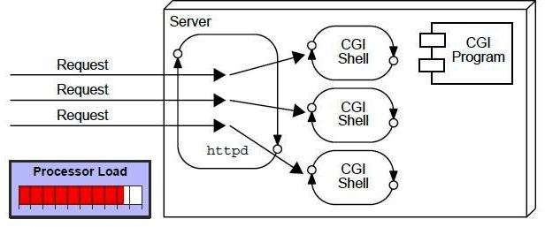
CGI(Commmon Gateway Interface)

Slide 4
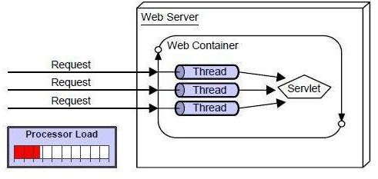
Advantage of Servlet
better performance: because it creates a thread for each request not process.
Portability: because it uses java language.
Robust: Servlets are managed by JVM so no need to worry about momory leak, garbage collection etc.
Secure: because it uses java language..

Slide 5
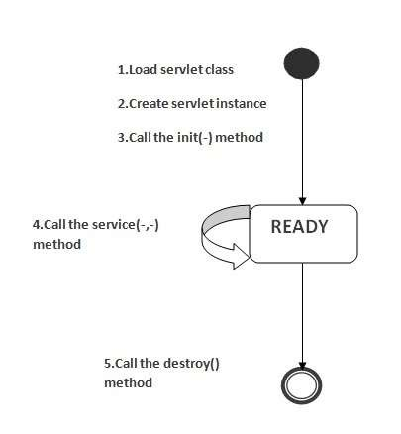
Life Cycle of a Servlet (Servlet Life Cycle)
The web container maintains the life cycle of a servlet instance. Let's see the life cycle of the servlet:
Servlet class is loaded.
Servlet instance is created.
init method is invoked.
service method is invoked.
destroy method is invoked.

Slide 6
Servlet API
The javax.servlet and javax.servlet.http packages represent interfaces and classes for servlet api.
Interfaces in javax.servlet package
There are many interfaces in javax.servlet package. They are as follows:
Servlet
ServletRequest
ServletResponse
RequestDispatcher
ServletConfig
ServletContext
Filter
FilterConfig
FilterChain

Slide 7
ServletRequest Interface
An object of ServletRequest is used to provide the client request information to a servlet such as content type, content length, parameter names and values, header informations, attributes etc.
Methods of ServletRequest interface:
public String getParameter(String name)
public String[] getParameterValues(String name)
java.util.Enumeration getParameterNames()
public int getContentLength()
public String getCharacterEncoding()
public String getContentType()
public ServletInputStream getInputStream() throws IOException

Slide 8
RequestDispatcher in Servlet
The RequestDispacher interface provides the facility of dispatching the request to another resource it may be html, servlet or jsp. This interface can also be used to include the content of another resource also. It is one of the way of servlet collaboration.
Methods of RequestDispatcher interface
public void forward(ServletRequest request,ServletResponse response)throws ServletException,java.io.IOException
public void include(ServletRequest request,ServletResponse response)throws ServletException,java.io.IOException

Slide 9
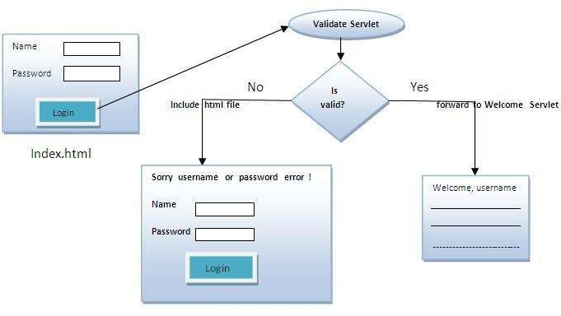
Example of RequestDispatcher interface

Slide 10
SESSION TRACKING IN SERVLETS
Session simply means a particular interval of time.
Session Tracking is a way to maintain state (data) of an user. It is also known as session management in servlet.
Http protocol is a stateless so we need to maintain state using session tracking techniques. Each time user requests to the server, server treats the request as the new request. So we need to maintain the state of an user to recognize to particular user.

Slide 11
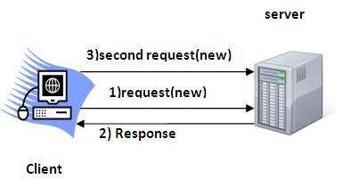
Session Tracking Techniques
There are four techniques used in Session tracking:
Cookies
Hidden Form Field
URL Rewriting
HttpSession

Slide 12
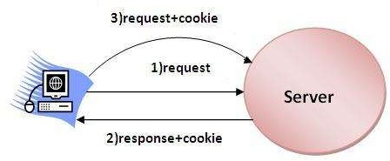
Cookies in Servlet
A cookie is a small piece of information that is persisted between the multiple client requests.
A cookie has a name, a single value, and optional attributes such as a comment, path and domain qualifiers, a maximum age, and a version number.

Slide 13
Advantage of Cookies
Simplest technique of maintaining the state.
Cookies are maintained at client side.
Disadvantage of Cookies
It will not work if cookie is disabled from the browser.
Only textual information can be set in Cookie object.

Slide 14
Hidden Form Field
In case of Hidden Form Field a hidden (invisible) textfield is used for maintaining the state of an user.
<input type="hidden" name="uname" value="Vimal Jaiswal">
Advantage of Hidden Form Field
It will always work whether cookie is disabled or not.
Disadvantage of Hidden Form Field:
It is maintained at server side.
Extra form submission is required on each pages.
Only textual information can be used.

Slide 15
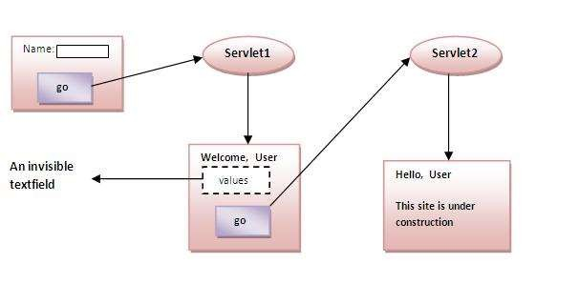
Example of using Hidden Form Field

Slide 16
URL Rewriting
In URL rewriting, we append a token or identifier to the URL of the next Servlet or the next resource. We can send parameter name/value pairs using the following format:
url?name1=value1&name2=value2&??
A name and a value is separated using an equal = sign, a parameter name/value pair is separated from another parameter using the ampersand(&).

Slide 17
Advantage of URL Rewriting
It will always work whether cookie is disabled or not (browser independent).
Extra form submission is not required on each pages.
Disadvantage of URL Rewriting
It will work only with links.
It can send Only textual information.

Slide 18
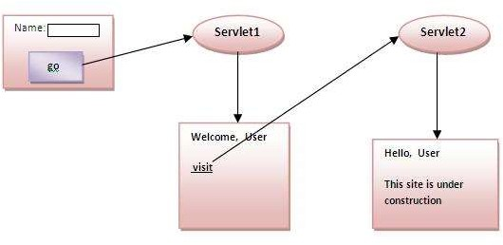
Example of using URL Rewriting

Slide 19
HttpSession interface
In such case, container creates a session id for each user. The container uses this id to identify the particular user. An object of HttpSession can be used to perform two tasks:
bind objects
view and manipulate information about a session, such as the session identifier, creation time, and last accessed time.
The HttpServletRequest interface provides two methods to get
the object of HttpSession:
public HttpSession getSession()
public HttpSession getSession(boolean create)

Slide 20
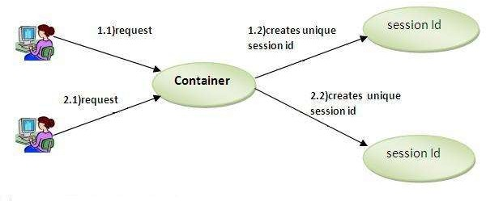

Slide 21
Event and Listener in Servlet
Events are basically occurrence of something. Changing the state of an object is known as an event.
Event classes
The event classes are as follows:
ServletRequestEvent
ServletContextEvent
ServletRequestAttributeEvent
ServletContextAttributeEvent
HttpSessionEvent
HttpSessionBindingEvent

